Slide 1
HOUSE PRICE PREDICTIONS PROJECT
Prepared By-
Purva Sonsare

Slide 2
INTRODUCTION BUSINESS PROBLEM FRAMING
Housing and real estate markets are important contributors to a country's economy. It is a huge market with many firms operating in it. Data Science may assist countries improve their total income, profitability, and marketing strategies by solving challenges in this sector. Machine learning techniques may be utilized to help this housing company achieve its commercial objectives. Our problem is with a housing company based in the United States called Surprise Housing, which wants to enter the Australian market. The company intends to use Data Analytics to buy houses at a discount from their true value and resell them at a profit. The company has compiled a dataset based on house sales in Australia. The firm is looking at potential properties to purchase residences in order to enter the market. We will create a model utilizing Machine Learning to estimate the actual worth of potential properties, which will assist the firm in deciding whether or not to invest in real estate.

Slide 3
CONCEPTUAL BACKGROUND OF THE DOMAIN PROBLEM
A US-based housing company named Surprise Housing has decided to enter the Australian market. The company uses data analytics to purchase houses at a price below their actual values and flip them at a higher price. For the same purpose, the company has collected a data set from the sale of houses in Australia. The data is provided in the CSV file below.
The company is looking at prospective properties to buy houses to enter the market. You are required to build a model using Machine Learning in order to predict the actual value of the prospective properties and decide whether to invest in them or not. For this company wants to know:
Which variables are important to predict the price of a variable?
How do these variables describe the price of the house?
Review of Literature
The world is evolving away from manual processes and toward automated ones. The goal of our project is to alleviate the customer's issues. In the current circumstance, the consumer goes to a real estate agent so that he or she may recommend acceptable showplaces for his assets. However, the above strategy is risky because the agent may forecast incorrect rates to the customer, resulting in a loss of the customer's investment. This manual approach, which is currently being utilized in the market, is out of date and dangerous.

Slide 4
MOTIVATION OF THE PROBLEM UNDERTAKEN
Our main objective of doing this project is to build a model to predict the house prices with the help of other supporting features. We are going to predict by using Machine Learning algorithms.
The sample data is provided to us from our client database. In order to improve the selection of customers, the client wants some predictions that could help them in further investment and improvement in selection of customers.
House Price Index is commonly used to estimate the changes in housing price. Since housing price is strongly correlated to other factors such as location, area, population, it requires other information apart from HPI to predict individual housing price.
There has been a considerably large number of papers adopting traditional machine learning approaches to predict housing prices accurately, but they rarely concern themselves with the performance of individual models and neglect the less popular yet complex models.
As a result, to explore various impacts of features on prediction methods, this paper will apply both traditional and advanced machine learning approaches to investigate the difference among several advanced models. This paper will also comprehensively validate multiple techniques in model implementation on regression and provide an optimistic result for housing price prediction.

Slide 5
ANALYTICAL PROBLEM FRAMING MATHEMATICAL/ANALYTICAL MODELLING OF THE PROBLEM
We are building a model in Machine Learning to predict the actual value of the prospective properties and decide whether to invest in them or not. So, this model will help us to determine which variables are important to predict the price of variables & also how do these variables describe the price of the house. This will help to determine the price of houses with the available independent variables. They can accordingly manipulate the strategy of the firm and concentrate on areas that will yield high returns.
Regression analysis is a set of statistical processes for estimating the relationships between a dependent variable (often called the 'outcome variable') and one or more independent variables (often called 'predictors', 'covariates', or 'features'). The most common form of regression analysis is linear regression, in which one finds the line (or a more complex linear combination) that most closely fits the data according to a specific mathematical criterion. For specific mathematical reasons this allows the researcher to estimate the conditional expectation of the dependent variable when the independent variables take on a given set of values.
Regression analysis is also a form of predictive modelling technique which investigates the relationship between a dependent (target) and independent variable (predictor). This technique is used for forecasting, time series modelling and finding the causal effect relationship between the variables.

Slide 6
The different Mathematical/Analytical models that are used in this project are as below:
Linear Regression, Lasso, Ridge, Elastic Net, KNeighborsRegressor, Decision Tree Regressor, Random
Forest Regressor, Adaboost Regressor, GradientBoostingRegressor
First, use the train dataset and do the EDA process, fitting the best model and saving the model.
Then, use the test dataset, load the saved model and predict the values over the test data.

Slide 7
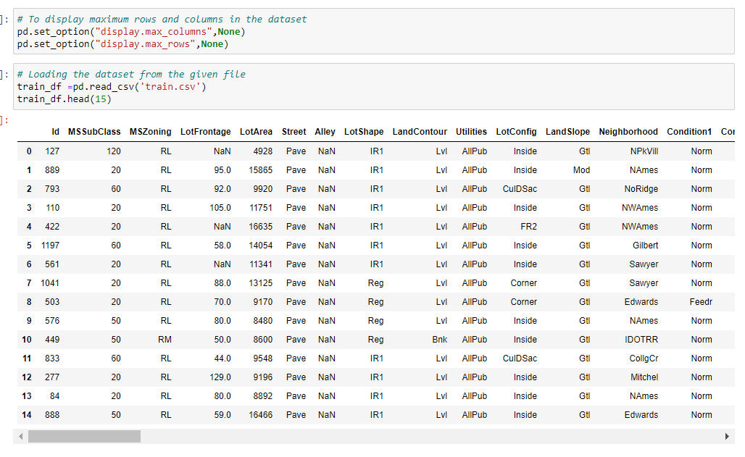
DATA SOURCES AND THEIR FORMATS

Slide 8
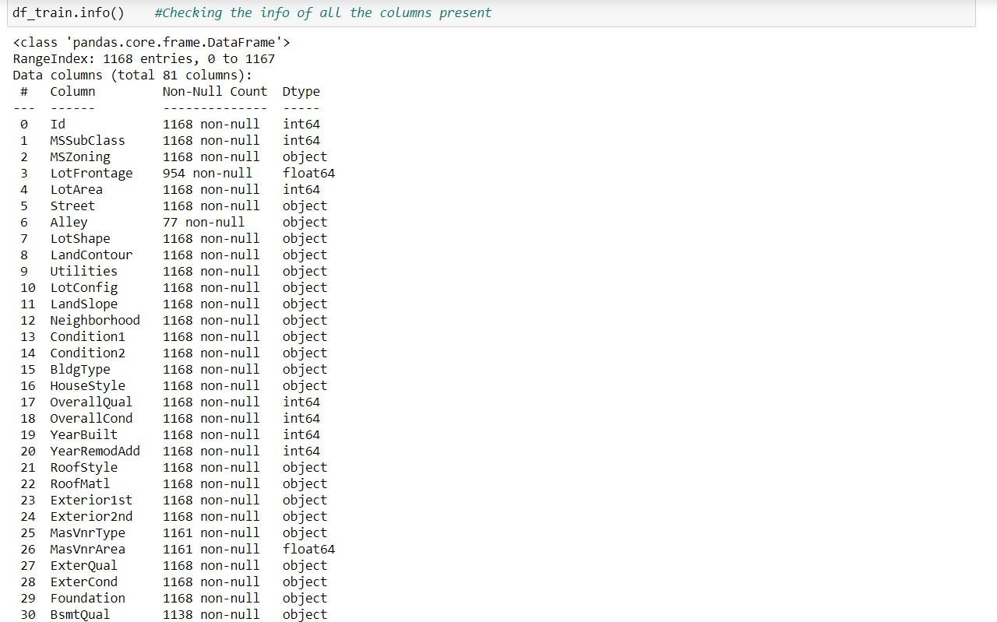
CHECKING NULL VALUES

Slide 9
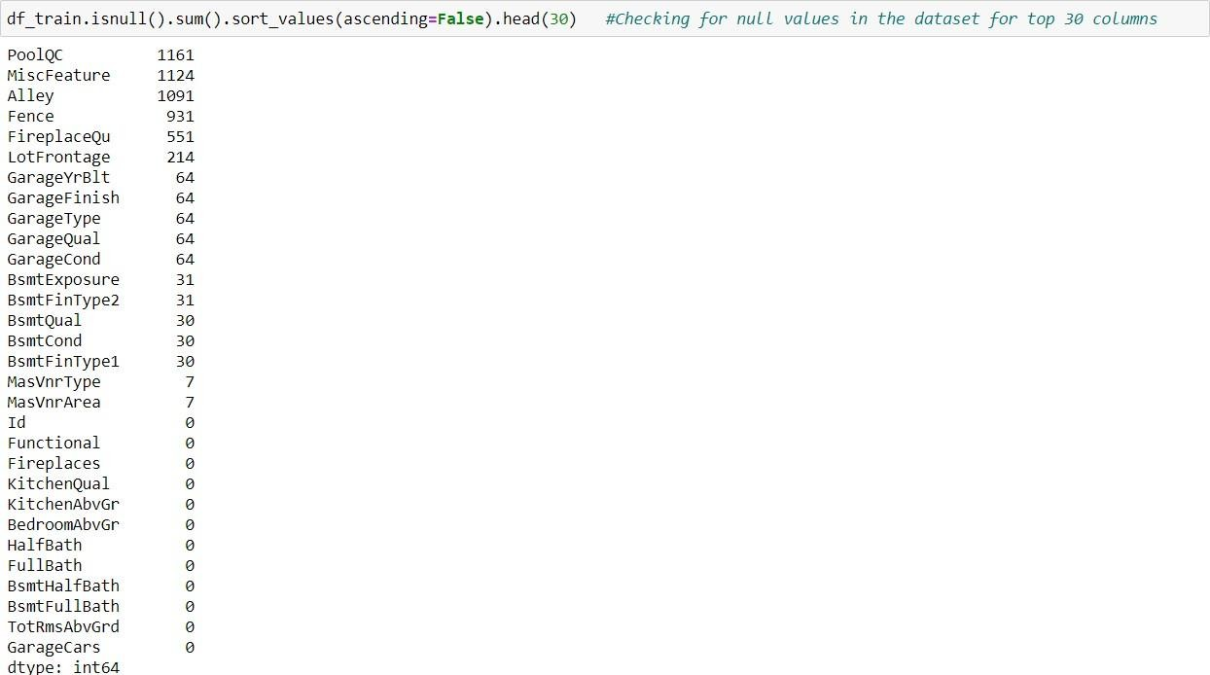
DATA PREPROCESSING
Data pre-processing in Machine Learning refers to the technique of preparing (cleaning and organizing) the raw data to make it suitable for a building and training Machine Learning models. In other words, whenever the data is gathered from different sources it is collected in raw format which is not feasible for the analysis. Data pre-processing is an integral step in Machine Learning as the quality of data and the useful information that can be derived from it directly affects the ability of our model to learn; therefore, it is extremely important that we pre- process our data before feeding it into our model.
CHECKING THE VALUE COUNTS OF CATEGORICAL DATA

Slide 10
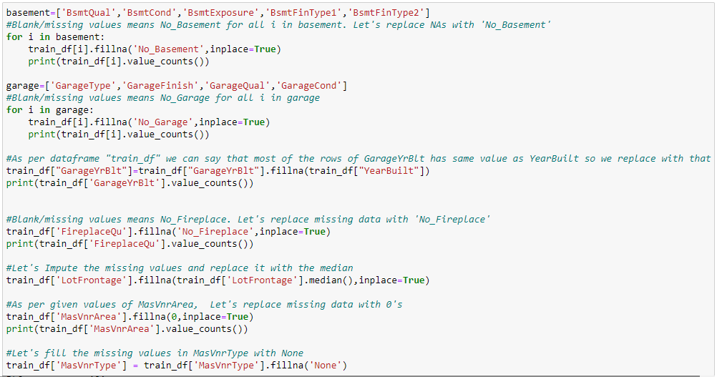
HANDLING MISSING DATA

Slide 11
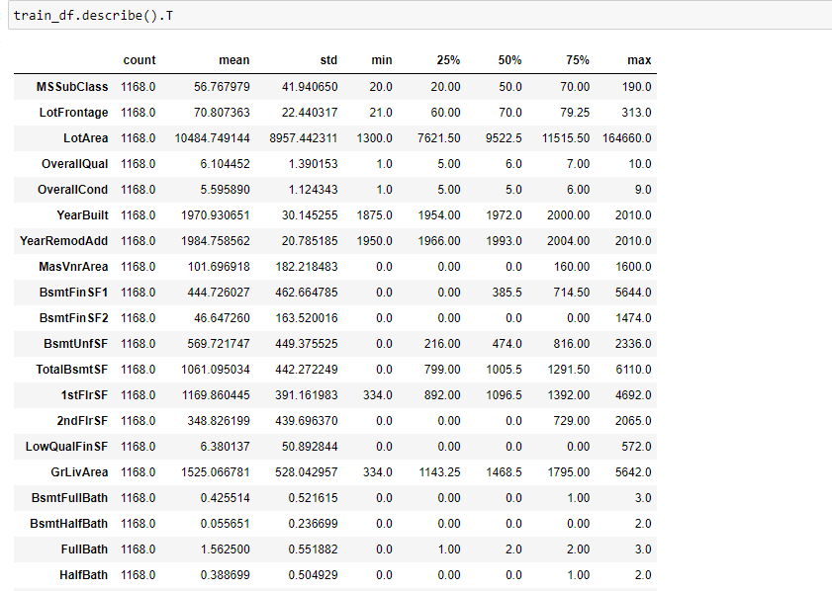
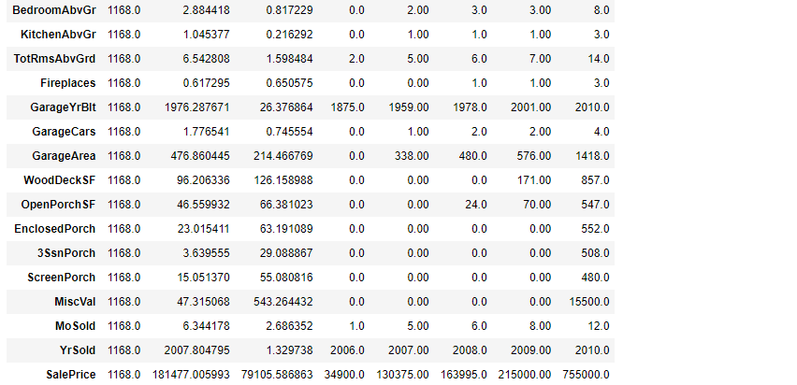
STATISTICAL SUMMARY
In descriptive statistics, summary statistics are used to summarize a set of observations, in order to communicate the largest amount of information as simply as possible. Summary statistics summarize and provide information about your sample data. It tells something about the values in data set. This includes where the average lies and whether the data is skewed.
The describe() function computes a summary of statistics pertaining to the Data Frame columns. This function gives the mean, count, max, standard deviation and IQR values of the dataset in a simple understandable way.

Slide 12
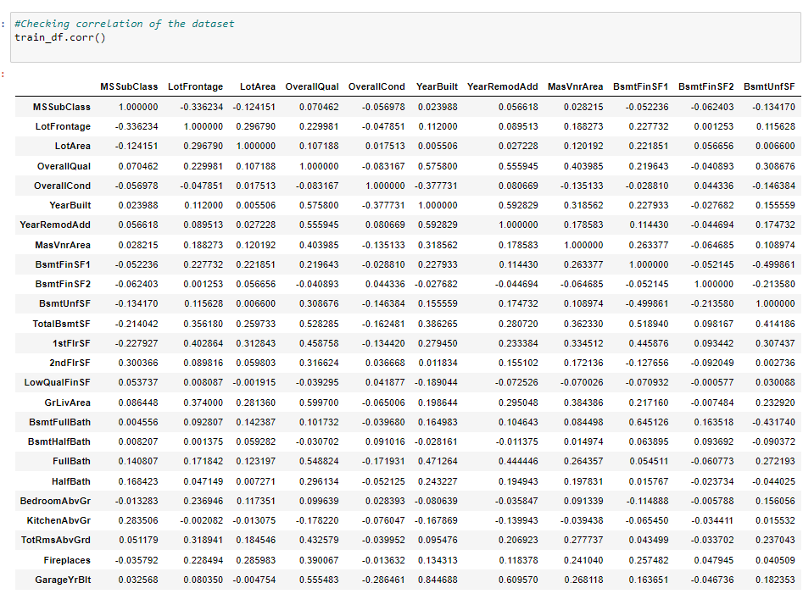
CORRELATION FACTOR
The statistical relationship between two variables is referred to as their correlation. The correlation factor represents the relation between columns in a given dataset. A correlation can be positive, meaning both variables are moving in the same direction or it can be negative, meaning that when one variable's value increasing, the other variable’s value is decreasing.

Slide 13
CORRELATION MATRIX AND ITS VISUALIZATION
A correlation matrix is a tabular data representing the ‘correlations’ between pairs of variables in a given dataset. It is also a very important pre-processing step in Machine Learning pipelines. The Correlation matrix is a data analysis representation that is used to summarize data to understand the relationship between various different variables of the given dataset.

Slide 14
CORRELATION WITH TARGET VARIABLE
'MSSubClass’,'OverallCond’,'OverallCond’,'LowQualFinSF’,'BsmtHalfBath’,'KitchenAbvGr’,'YrSold','EnclosedPorch','MiscVal' are negatively correlated with the target column, rest all are positively correlated
'OverallQual' & 'GrLivArea' are highly positively correlated with target column
'MSSubClass','OverallCond','OverallCond’,'LowQualFinSF’,'BsmtHalfBath’,'YrSold', 'MiscVal', 'MoSold', '3SsnPorch' are least correlated with the target column

Slide 15
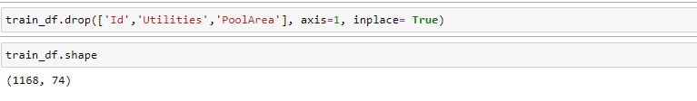
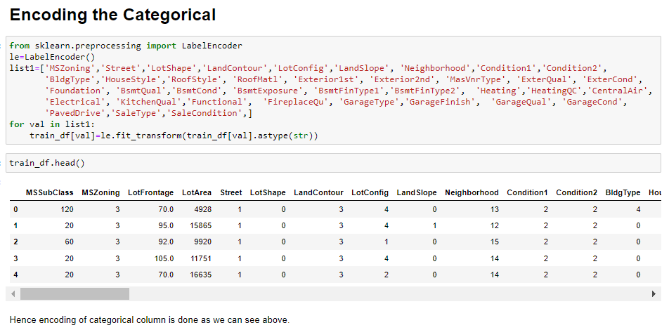
DROPPING UNNECESSARY COLUMNS AND ENCODING NON-NUMERIC DATA USING LABEL ENCODER

Slide 16
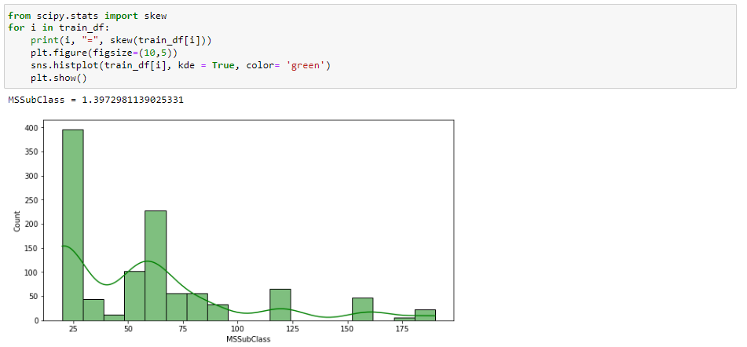
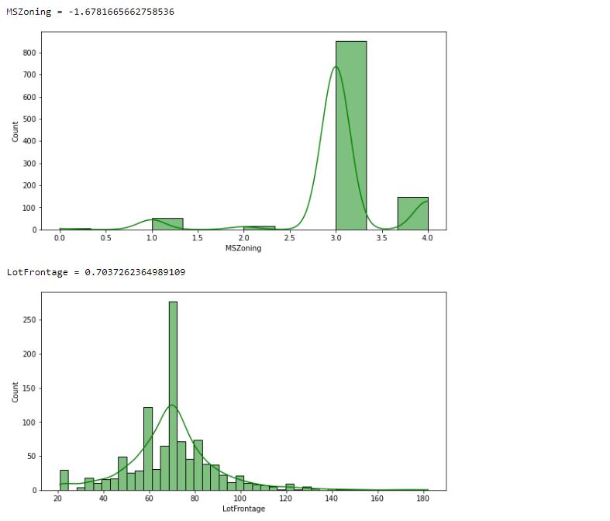
CHECKING SKEWNESS AND PLOTTING DIST PLOT
Skewness refers to distortion or asymmetry in a symmetrical bell curve, or normal distribution in a set of data. Besides positive and negative skew, distributions can also be said to have zero or undefined skew. The skewness value can be positive, zero, negative, or undefined.

Slide 17
CHECKING OUTLIERS AND PLOTTING IT
An outlier is a data point in a data set which is distant or far from all other observations available. It is a data point which lies outside the overall distribution which is available in the dataset. In statistics, an outlier is an observation point that is distant from other observations.
A box plot is a method or a process for graphically representing groups of numerical data through their quartiles. Outliers may also be plotted as an individual point. If there is an outlier it will plotted as point in box plot but other numerical data will be grouped together and displayed as boxes in the diagram. In most cases a threshold of 3 or -3 is used i.e., if the Z-score value is higher than or less than 3 or -3 respectively, that particular data point will be identified as outlier.

Slide 18
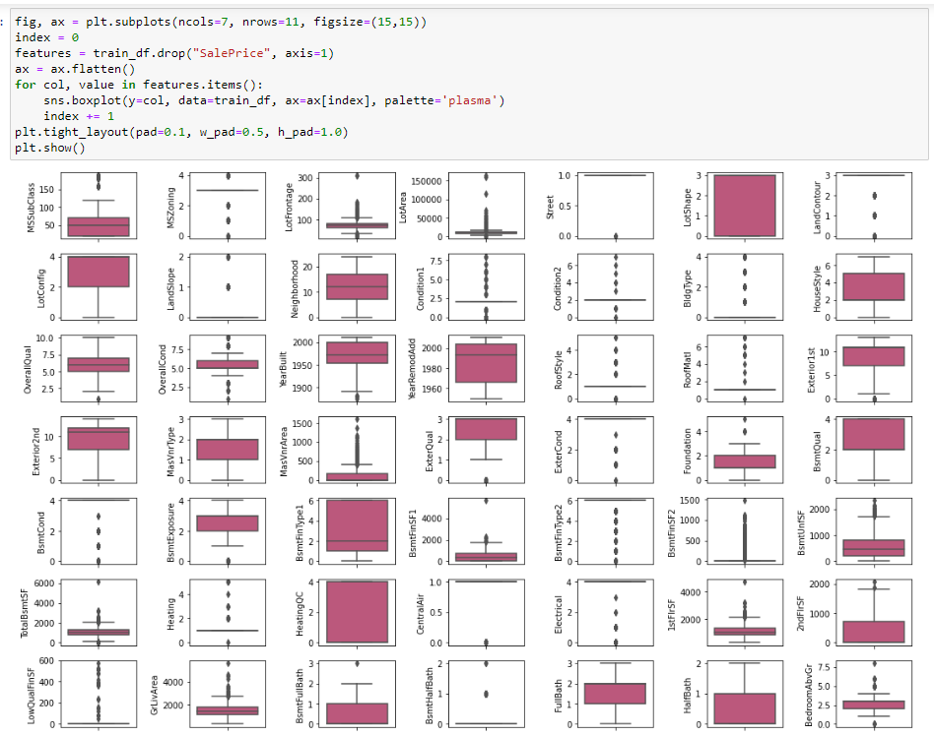

Slide 19
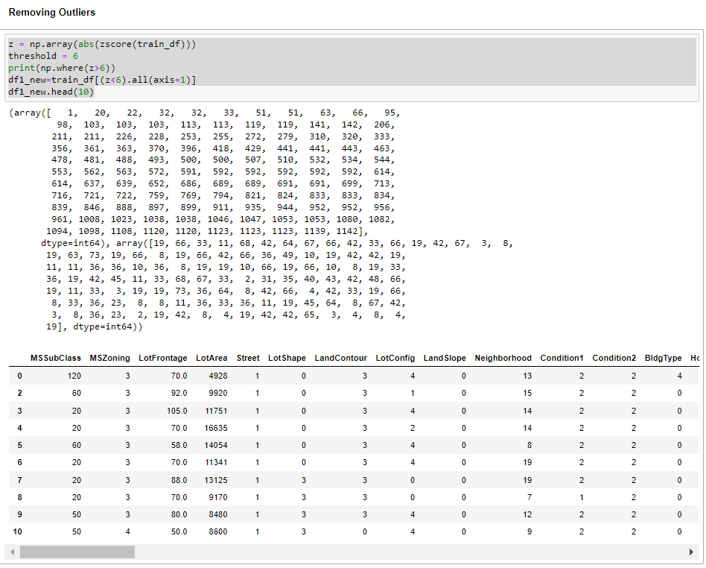

Slide 20
TREATING SKEWNESS
In the Data Science it is just statistics and many algorithms revolve around the assumption that the data is normalized. So, the more the data is close to normal, the better it is for getting good predictions. There are many ways of transforming skewed data such as log transform, square-root transform, box-cox transform, etc.
Log Transform
Log transformation is a data transformation method in which it replaces each variable x with a log(x). The log transformation is, arguably, the most popular among the different types of transformations used to transform skewed data to approximately conform to normality
2. Square Root Transform
The square root, x to x^ (1/2) = sqrt(x), is a transformation with a moderate effect on distribution shape: it is weaker than the logarithm and the cube root. It is also used for reducing right skewness, and also has the advantage that it can be applied to zero values. So, applying a square root transform inflates smaller numbers but stabilizes bigger ones.
3. Box-Cox Transform
In statistics, a power transform is a family of functions that are applied to create a monotonic transformation of data using power functions. This is a useful data transformation technique used to stabilize variance, make the data more normal distribution-like, improve the validity of measures of association such as the Pearson correlation between variables and for other data stabilization procedures.

Slide 21
HARDWARE AND SOFTWARE REQUIREMENTS AND TOOLS USED
For doing this project, the hardware used is a laptop with high end specification and a stable internet connection. While coming to software part, I had used anaconda navigator and in that I have used Jupyter notebook to do my python programming and analysis.
For using a csv file, Microsoft excel is needed. In Jupyter notebook, I had used lots of python libraries to carry out this project and I have mentioned below with proper justification:
1. Pandas- a library which is used to read the data, visualisation and analysis of data.
2. NumPy- used for working with array and various mathematical techniques.
3. Seaborn- visualization tool for plotting different types of plot.
4. Matplotlib- It provides an object-oriented API for embedding plots into applications.
5. zscore- technique to remove outliers.
6. skew ()- to treat skewed data using various transformation like sqrt, log, cube, boxcox, etc.
7. PCA- I used this to reduce the data dimensions to 10 columns.
8. standard scaler- I used this to scale my data before sending it to model.
9. train_test_split- to split the test and train data.
10. Then I used different classification algorithms to find out the best model for predictions.
11. joblib- library used to save the model in either pickle or obj file.

Slide 22
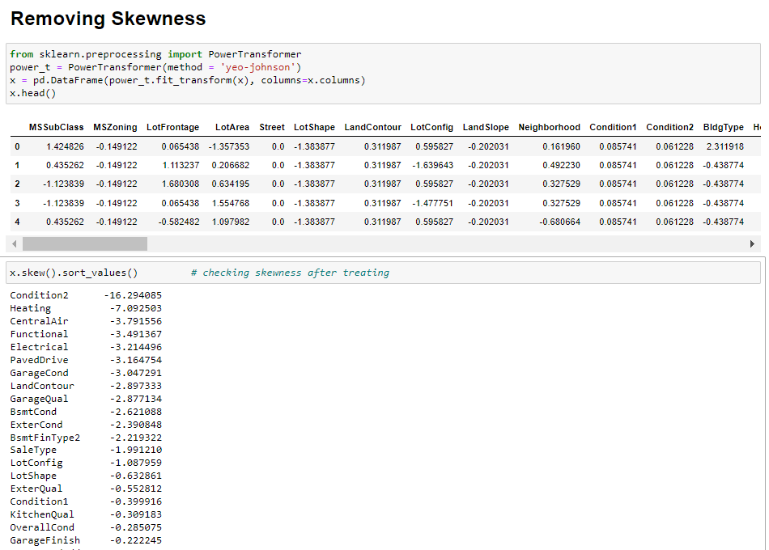

Slide 23
MODEL/S DEVELOPMENT AND EVALUATION
From the given dataset it can be concluded that it is a Regression problem as the output column “SalesPrice” has continuous output. So, for further analysis of the problem, we have to import or call out the Regression related libraries in Python work frame.
The different libraries used for the problem solving are:
Sklearn
Sklearn.linear_model
Sklearn.ensemble
Sklearn.metrics
Sklearn.model_selection

Slide 24
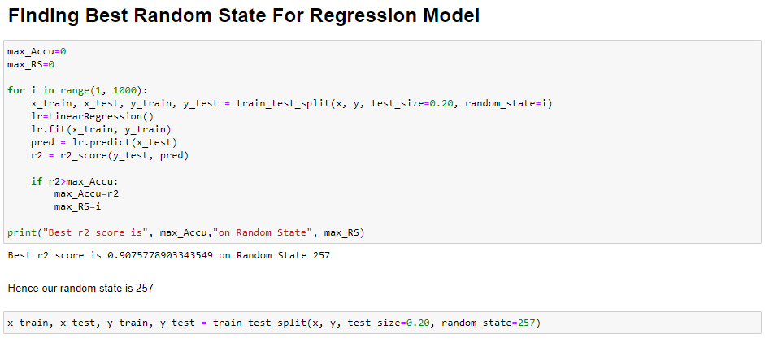
TESTING OF IDENTIFIED APPROACHES
After completing the required pre-processing techniques for the model building data is separated as input and output columns before passing it to the train_test_split.

Slide 25
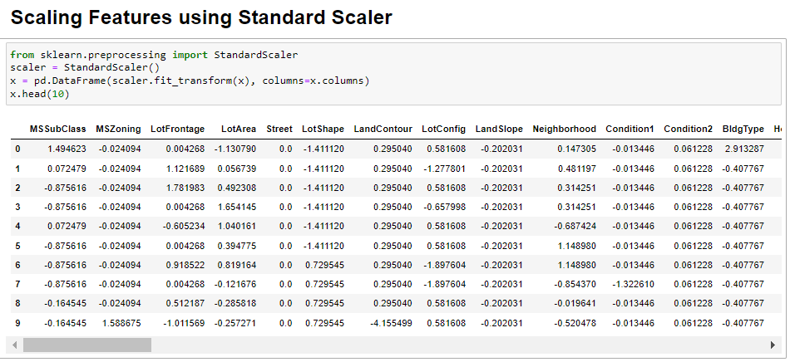
SCALING THE DATA USING STANDARD SCALER
For each value in a feature, StandardScaler subtracts the minimum value in the feature and then divides by the range. The range is the difference between the original maximum and original minimum. StandardScaler preserves the shape of the original distribution.

Slide 26
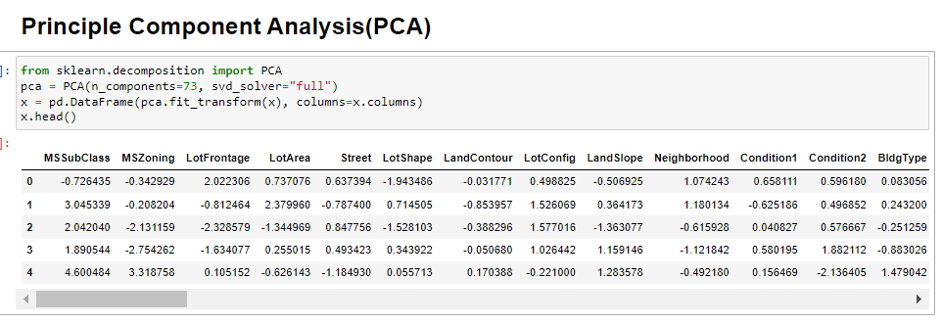
USING PCA
An important machine learning method for dimensionality reduction is called Principal Component Analysis. It is a method that uses simple matrix operations from linear algebra and statistics to calculate a projection of the original data into the same number or fewer dimensions.

Slide 27
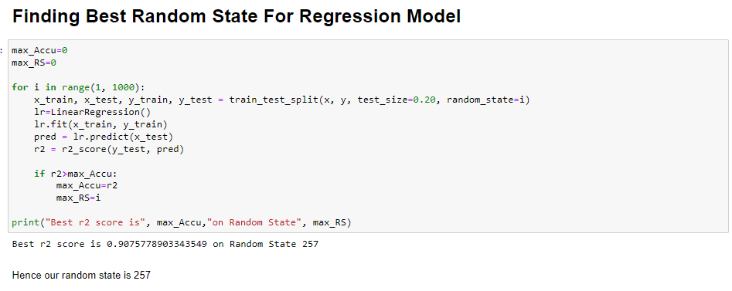
RUN AND EVALUATE SELECTED MODELS
We will find the best random state value so that we can create our train_test_split

Slide 28
Scikit-learn is a Python library that offers various features for data processing that can be used for classification, clustering, and model selection. Model_selection is a method for setting a blueprint to analyze data and then using it to measure new data. Selecting a proper model allows you to generate accurate results when making a prediction. If we have one dataset, then it needs to be split by using the Sklearn train_test_split function first. By default, Sklearn train_test_split will make random partitions for the two subsets.
The train_test_split is a function in Sklearn model selection for splitting data arrays into two subsets: for training data and for testing data. With this function, we don't need to divide the dataset manually. The train_test_split function is for splitting a single dataset for two different purposes: training and testing. The testing subset is for building your model. The testing subset is for using the model on unknown data to evaluate the performance of the model.
Creating train_test_split using best random_state
x_train,x_test,y_train,y_test=train_test_split(x,y,random_state=85,test_size=.20)
Now, we will run a for loop for all regression algorithms and find the best model

Slide 29
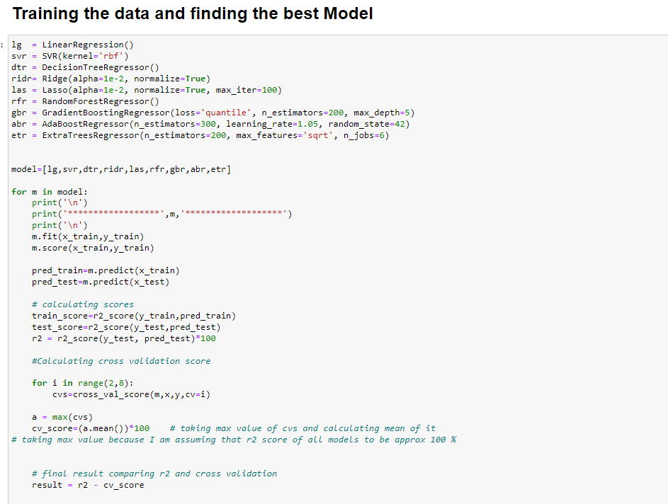
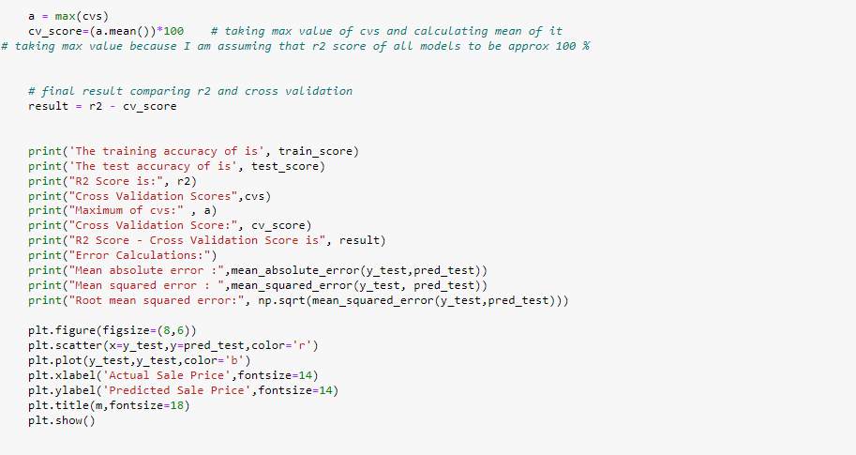
As you can see above, I had called the algorithms, then I called the empty list with the name models [ ], and calling all the model one by one and storing the result in that.
We can observe that I imported the metrics in order to interpret the model’s output. Then I also selected the model to find the cross_validation_score value.

Slide 30
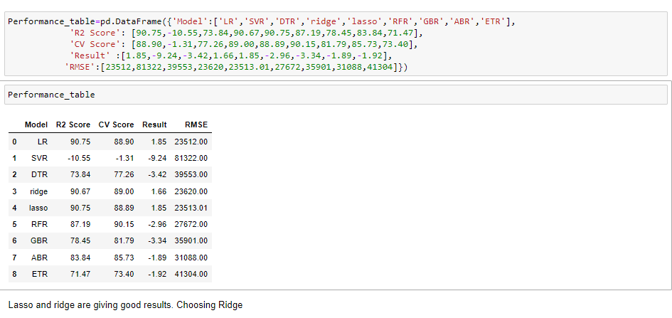
The following are the outputs of the different algorithms I had used, along with the metrics score obtained and after finalizing the outputs in a data frame, it will be as follows:
We can see that Ridge and Lasso Regression algorithms are performing well, as compared to other algorithms. Now we will try Hyperparameter Tuning Ridge Regression to find out the best parameters and try to increase their scores.

Slide 31
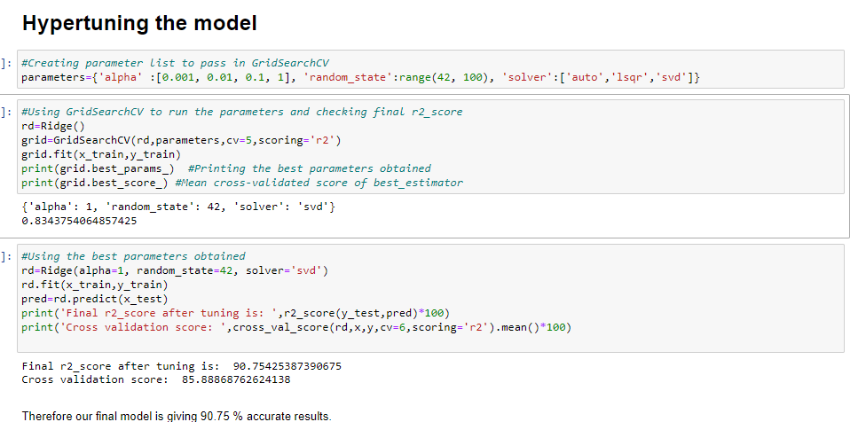
KEY METRICS FOR SUCCESS IN SOLVING PROBLEM UNDER CONSIDERATION
The key metrics used here were r2_score, cross_val_score, sd, MAE, MSE and RMSE. We tried to find out the best parameters and also to increase our scores by using Hyperparameter Tuning and we will be using GridSearchCV method.

Slide 32
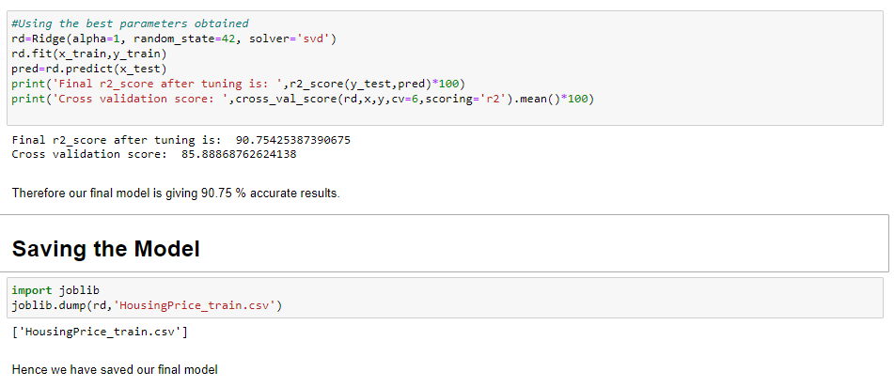
FINALIZE THE MODEL

Slide 33
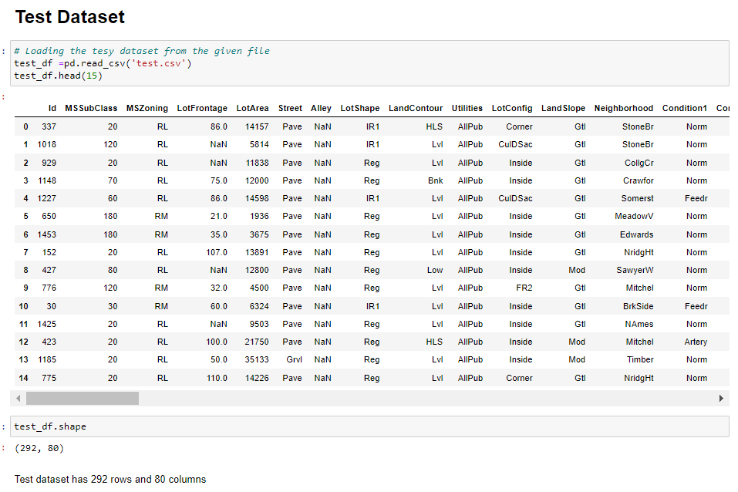
USING THE TEST DATASET AND DOING PRE-PROCESSING
Here, we will be doing the same steps as we did for training dataset like handling missing data, dropping unnecessary columns, encoding non-categorical data, treating skewness, etc.
Then, we will scale the data and do PCA analysis according to the best model requirements.

Slide 34
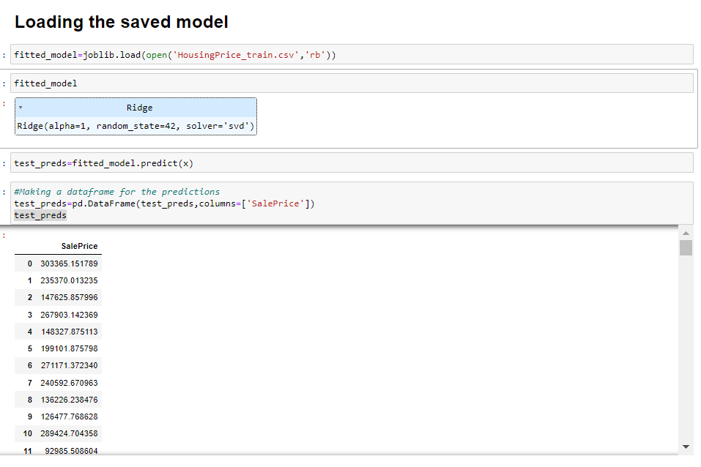
PREDICTING OVER TEST DATA

Slide 35
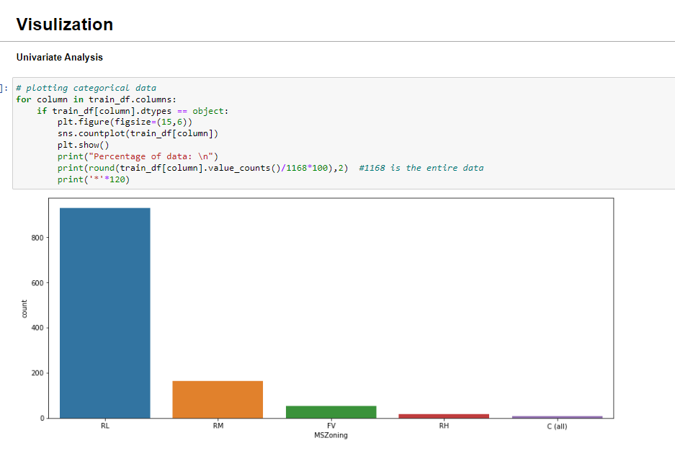
DATA VISUALIZATION
Now, we will see the different plots done with this dataset in order to know the insight of the data present. Below are the codes given for the plots and the output obtained:

Slide 36
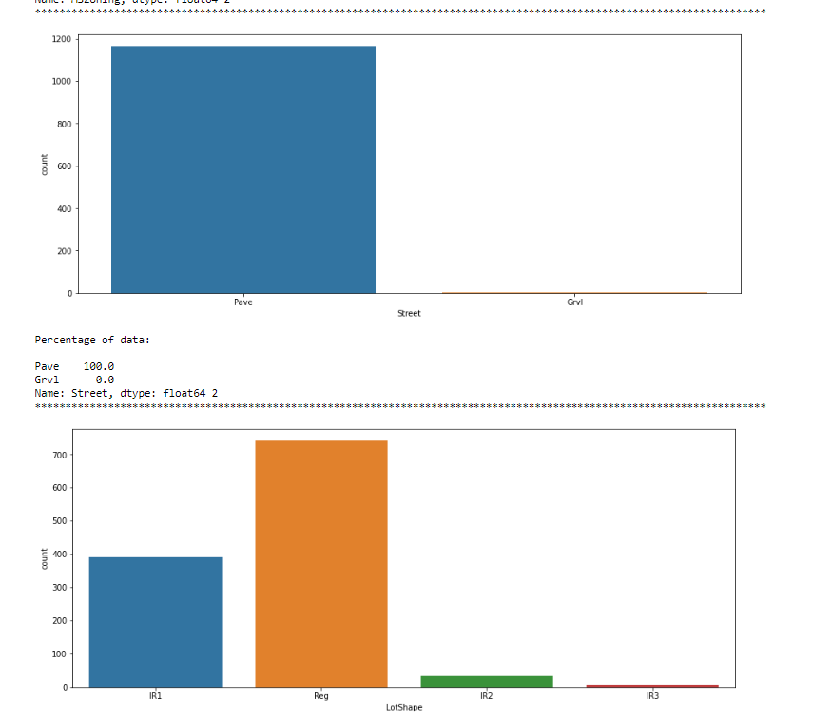
PLOTTING GRAPHS FOR CATEGORICAL DATA

Slide 37
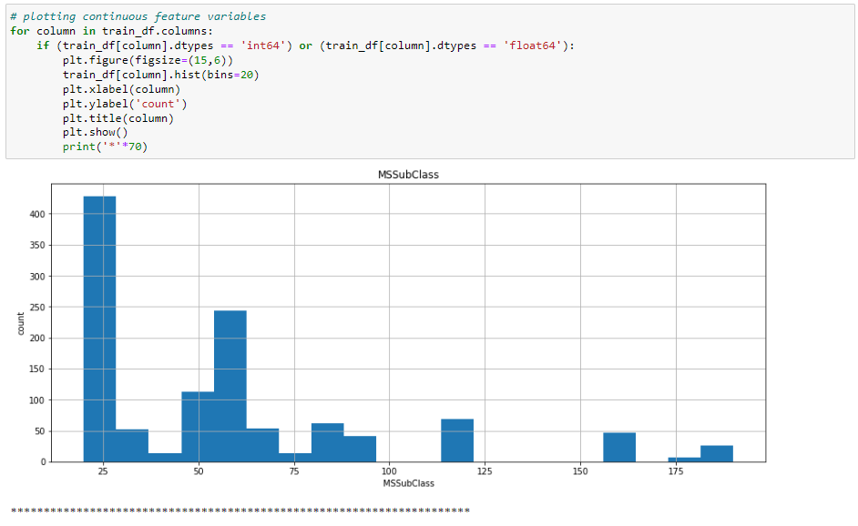
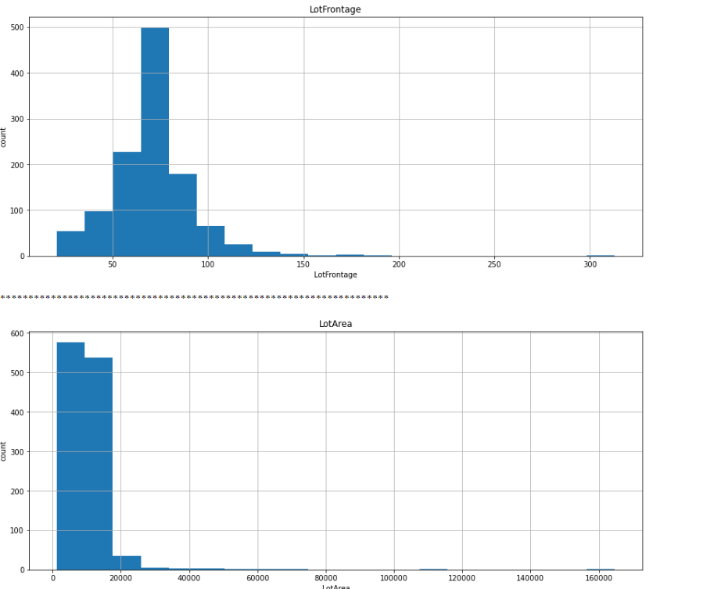
TAKING ALL CONTINUOUS DATA AND PLOTTING HISTOGRAM

Slide 38
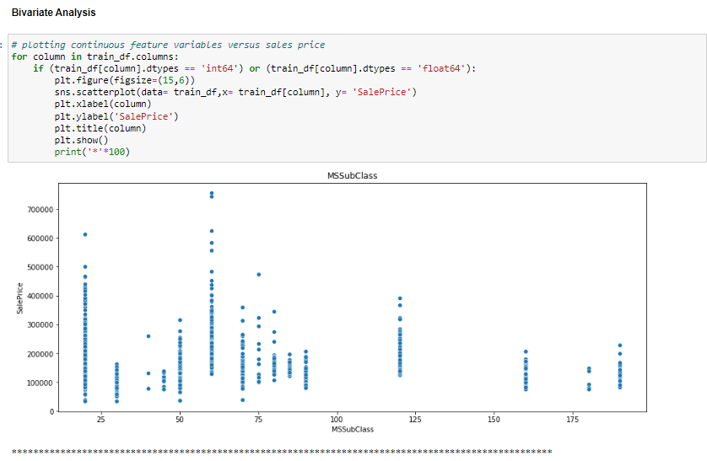
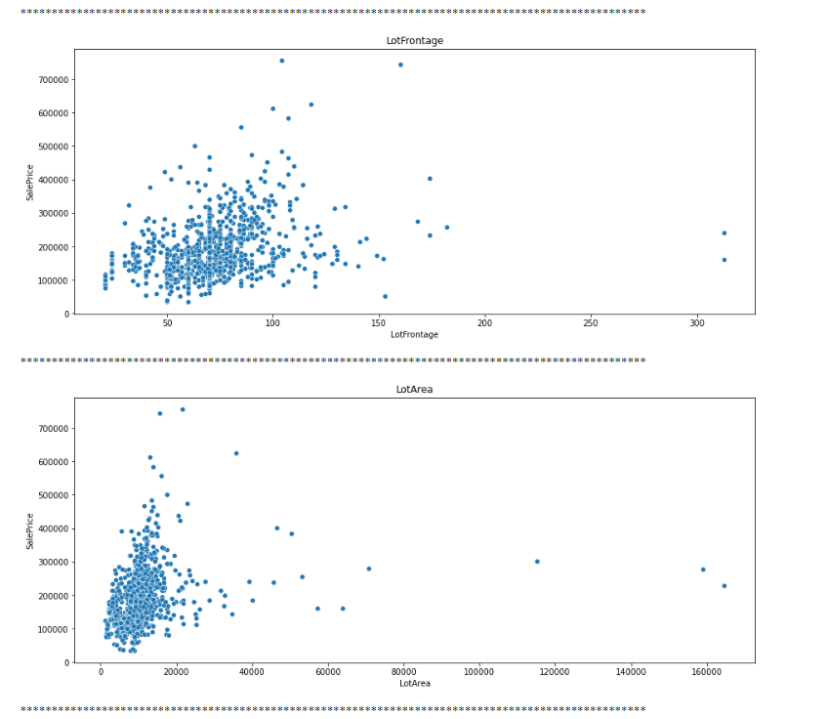
BIVARIATE ANALYSIS

Slide 39
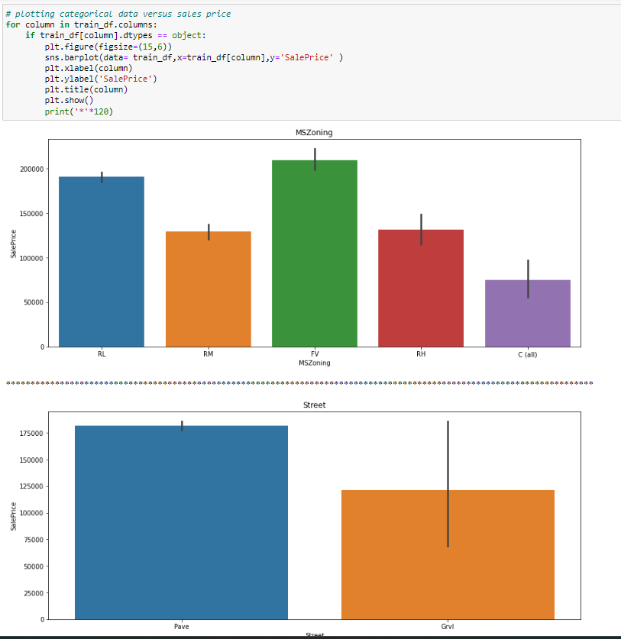
PLOTTING FOR CATEGORICAL DATA

Slide 40
CONCLUSION
After getting an insight of this dataset, we were able to understand that the Housing prices are done on basis of different features.
First, we loaded the train dataset and did the EDA process and other pre-processing techniques like skewness check and removal, handling the outliers present, filling the missing data, visualizing the distribution of data, etc.
Then we did the model training, building the model and finding out the best model on the basis of different metrices scores we got like Mean Absolute Error, Mean squared Error, Root Mean Squared Error, etc.
We got Ridge Regressor as the best algorithm among all as it gave more r2_score and cross_val_score. Then for finding out the best parameter and improving the scores, we performed Hyperparameter Tuning.
We saved the model in a pickle with a filename in order to use whenever we require.
We predicted the values obtained and saved it separately in a csv file.
Then we used the test dataset and performed all the pre-processing pipeline methods to it.

Slide 41
After treating skewness and outliers, we loaded the saved model that we obtained and did the predictions over the test data and then saving the predictions separately in a csv file.
From this project, we learnt that how to handle train and test data separately and how to predict the values from them. This will be useful while we are working in a real-time case study as we can get any new data from the client we work on and we can proceed our analysis by loading the best model we obtained and start working on the analysis of the new data we have.
The final result will be the predictions we get from the new data and saving it separately.
Overall, we can say that this dataset is good for predicting the Housing prices using regression analysis and RidgeRegressor is the best working algorithm model we obtained.
We can improve the data by adding more features that are positively correlated with the target variable, having less outliers, normally distributed values, etc.

Slide 42
LEARNING OUTCOMES OF THE STUDY IN RESPECT OF DATA SCIENCE
Price Prediction modeling – This allows predicting the prices of houses & how they are varying in nature considering the different factors affecting the prices in the real time scenarios.
Prediction of Sale Price – This helps to predict the future revenues based on inputs from the past and different types of factors related to real estate & property related cases. This is best done using predictive data analytics to calculate the future values of houses. This helps in segregating houses, identifying the ones with high future value, and investing more resources on them.
Deployment of ML models – The Machine learning models can also predict the houses depending upon the needs of the buyers and recommend them, so customers can make final decisions as per the needs.
We see how to deal with outliers when all the rows have at least one value Z>3.
To do a visualization when data has high standard deviation and no Classification

Slide 43
LIMITATIONS OF THIS WORK AND SCOPE FOR FUTURE WORK
1. The biggest limitation I observed was that not all categories of a particular feature were available in the training data. So, if there were new category in the test data the model would not be able to identify that.
Example: MSZoning has 8 categories
A Agriculture
C Commercial
FV Floating Village Residential
I Industrial
RH Residential High Density
RL Residential Low Density
RP Residential Low-Density Park
RM Residential Medium Density
2. However in the Training dataset only 5 categories are present, what happen if other 3 categories will present in test data in future. It would be difficult for machine to identify and predict.
3. The high skewness of data reduces the effectivity
4.Many features have NaN values more than 50%, and imputation of them can decrease the effectiveness. And dropping them had the loss of data.
5.we can increase the efficiency of a model by selecting a better method to remove outliers and skewness also how to make the search of perfect model in a way that if we want to change some parameters in model then we don't have to run all the model again

Slide 44


